Slide 1
Waste to energy conversion

Slide 2

Waste to Energy
The increasing industrialization, urbanization and changes in the pattern of life give rise to generation of increasing quantities of wastes.
Scarcity of fossil fuels particularly petroleum crude is forcing us to develop some clean technology for the utilization of the fossil fuels as well as to utilize renewal resources.
In recent years, technologies have been developed that not only help in generating substantial quantity of decentralized energy but also in reducing the quantity of waste for its safe disposal.

Slide 3
Types of waste
There are different types of waste which are generated from our daily or industrial activities such as organic waste, e-waste, hazardous waste, inert waste etc.
Organic waste refers to waste which degrades or broken down by microorganisms over time. All organic wastes are essentially carbon based compounds.
Organic waste has significant portion in overall waste generation in industrial/urban/ agricultural sector and therefore it can be used for energy generation.

Slide 4
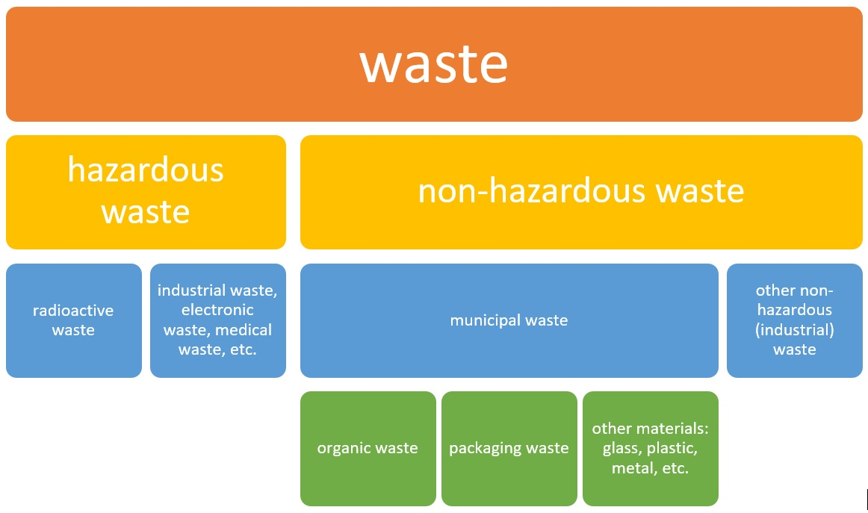

Slide 5
Important Parameters of different types of waste
Solid Waste | Waste Water | Waste Gas
Elemental Composition C, H, N, O & S | BOD & TOC | Particulate Matter
Moisture, Volatile & Ash content | pH, | Nox, Sox and CO
Bulk Density, | TDS and TSS | Heavy metal ions
Heating Value | Cations and anions | Hydrocarbon and other fuel
Hence the factors like Carbon content of solid waste , BOD and sludge content of liquid fuels and Combustible gas content of gaseous waste are important parameters for converting waste in to energy.

Slide 6
Composition of Municipal Waste

Slide 7
Need for energy production from waste
Waste to energy conversion gives the following advantages
1) It meets some energy demand, on the other way it gives some a systematic solid waste management system.
2) It helps us to achieve the sustainability goal of the society,
3) Decrease in production of green house gases
4) Reduction of dependance on fossils fuels
5) Waste to energy technology converts municipal waste into electric, heat and fuels
6) Reduction of waste going to land fills

Slide 8
Methods of production of energy from waste
1. Incineration: incineration is a waste treatment process that involves the combustion of organic substances content in waste materials
2. Gasification: gasification is a process that converts carbonaceous feedstocks into combustible gasses including H₂ and CO mainly carbon monoxide and hydrogen dioxide gas.
3. Pyrolysis: pyro means fire, lysis means cutting. So, this is the process that is thermal decomposition process which decomposes carbonaceous material by the application of heat in absence of oxygen.
4. Anerobic Digestion: In an oxygen-free tank, this material is broken down to biogas and fertilizer.
In incineration we used excess amount of oxygen in gasification we use controlled amount of oxygen and in pyrolysis we use no oxygen theoretically.

Slide 9
E-waste
Electronic waste or E-waste describes the discarded electrical or electronic devices.
Sources of e-waste
Waste produced due to data generating & processing devices like computers, monitors, speakers,keyboards, printers etc.
Electronic devices used in TV, DVDs and CDs.
Equipment's used in communication like phones, landlines phones, mobiles etc.
Household equipment like vacum cleaner, microwave ovens, washing machines, air conditioners etc

Slide 10
Effect of e-waste on environment
Emission from e-waste create environmental damage
Toxic chemicals from e-waste enter into soil-crop-food pathway.
They are non-biodegradable causing pollution of soil
E-waste dumping yards causes pollution and health hazards.
It cause health hazards due to lead, mercury, cadmium poisoning

Slide 11
E-wate management
Common methods
Landfill disposal
Incineration
Acid treatment
Advanced method
Recycling
It involves
Disassembling-carefully separating various components
Upgrading-involves mechanical or chemical or metallurgical methods to recover the metals
Glass, plastic, metals can be recovered and then mixed with other ingredients to produced many valuable recycled products.

Slide 12
Thank you

